Slide 1
Lecture 6: Classification and Logistic Regression

Slide 2
Lecture Outline
Why not Linear Regression?
Binary Response & Logistic Regression
Estimating the Simple Logistic Model
Classification using the Logistic Model
Extending the Logistic Model
Multiple Logistic Regression
Classification Boundaries

Slide 3
Lecture 1-5 Advertising Data
X
predictors
features
covariates
Y
outcome
response variable
dependent variable
TV | radio | newspaper | sales
230.1 | 37.8 | 69.2 | 22.1
44.5 | 39.3 | 45.1 | 10.4
17.2 | 45.9 | 69.3 | 9.3
151.5 | 41.3 | 58.5 | 18.5
180.8 | 10.8 | 58.4 | 12.9
n observations
p predictors

Slide 4
Heart Data
response variable Y
is Yes/No
Age | Sex | ChestPain | RestBP | Chol | Fbs | RestECG | MaxHR | ExAng | Oldpeak | Slope | Ca | Thal | AHD
63 | 1 | typical | 145 | 233 | 1 | 2 | 150 | 0 | 2.3 | 3 | 0.0 | fixed | No
67 | 1 | asymptomatic | 160 | 286 | 0 | 2 | 108 | 1 | 1.5 | 2 | 3.0 | normal | Yes
67 | 1 | asymptomatic | 120 | 229 | 0 | 2 | 129 | 1 | 2.6 | 2 | 2.0 | reversable | Yes
37 | 1 | nonanginal | 130 | 250 | 0 | 0 | 187 | 0 | 3.5 | 3 | 0.0 | normal | No
41 | 0 | nontypical | 130 | 204 | 0 | 2 | 172 | 0 | 1.4 | 1 | 0.0 | normal | No

Slide 5
Heart Data
These data contain a binary outcome HD for 303 patients who presented with chest pain. An outcome value of:
Yes indicates the presence of heart disease based on an angiographic test,
No means no heart disease.
There are 13 predictors including:
Age
Sex
Chol (a cholesterol measurement),
MaxHR
RestBP
and other heart and lung function measurements.

Slide 6
Classification

Slide 7
Classification
Up to this point, the methods we have seen have centered around modeling and the prediction of a quantitative response variable (ex, number of taxi pickups, number of bike rentals, etc). Linear regression (and Ridge, LASSO, etc) perform well under these situations
When the response variable is categorical, then the problem is no longer called a regression problem but is instead labeled as a classification problem.
The goal is to attempt to classify each observation into a category (aka, class or cluster) defined by Y, based on a set of predictor variables X.

Slide 8
Typical Classification Examples
The motivating examples for this lecture(s), homeworks and coming labs are based on medical data sets. Classification problems are common in this domain:
Trying to determine where to set the cut-off for some diagnostic test (pregnancy tests, prostate or breast cancer screening tests, etc...)
Trying to determine if cancer has gone into remission based on treatment and various other indicators
Trying to classify patients into types or classes of disease based on various genomic markers

Slide 9
Why not Linear Regression?

Slide 10
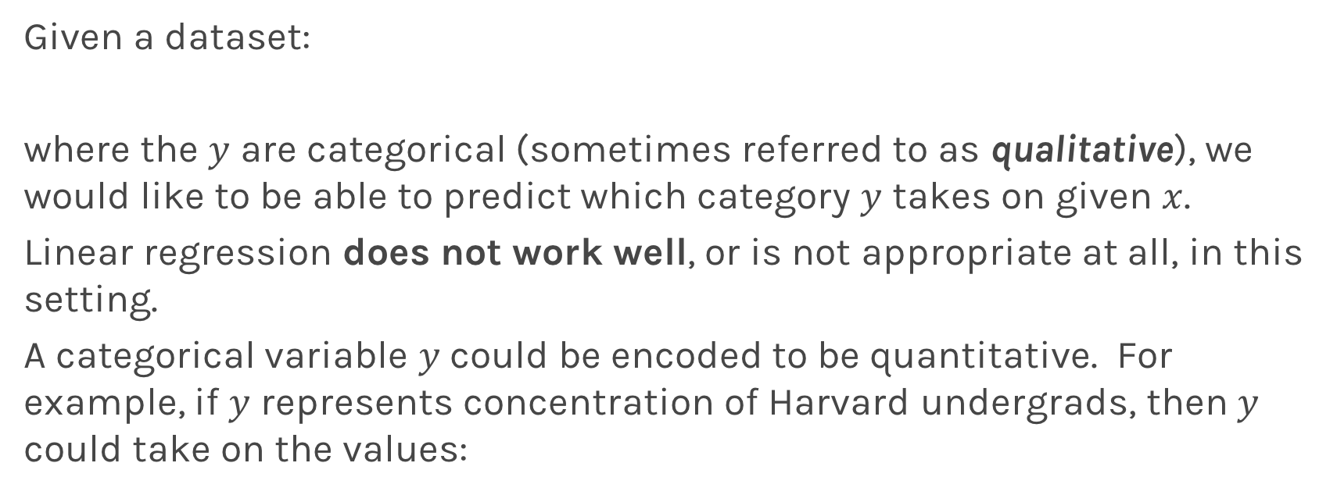
Simple Classification Example
Given a dataset:
where the $y$ are categorical (sometimes referred to as qualitative), we would like to be able to predict which category $y$ takes on given $x$.
Linear regression does not work well, or is not appropriate at all, in this setting.
A categorical variable $y$could be encoded to be quantitative. For example, if $y$ represents concentration of Harvard undergrads, then $y$ could take on the values:

Slide 11
Simple Classification Example
A linear regression could be used to predict y from x. What would be wrong with such a model?
The model would imply a specific ordering of the outcome, and would treat a one-unit change in y equivalent. The jump from y=1 to y=2 (CS to Statistics) should not be interpreted as the same as a jump from y=2 to y=3 (Statistics to everyone else).
Similarly, the response variable could be reordered such that y=1 represents Statistics and y=2 represents CS, and then the model estimates and predictions would be fundamentally different.
If the categorical response variable was ordinal (had a natural ordering, like class year, Freshman, Sophomore, etc.), then a linear regression model would make some sense but is still not ideal.

Slide 12
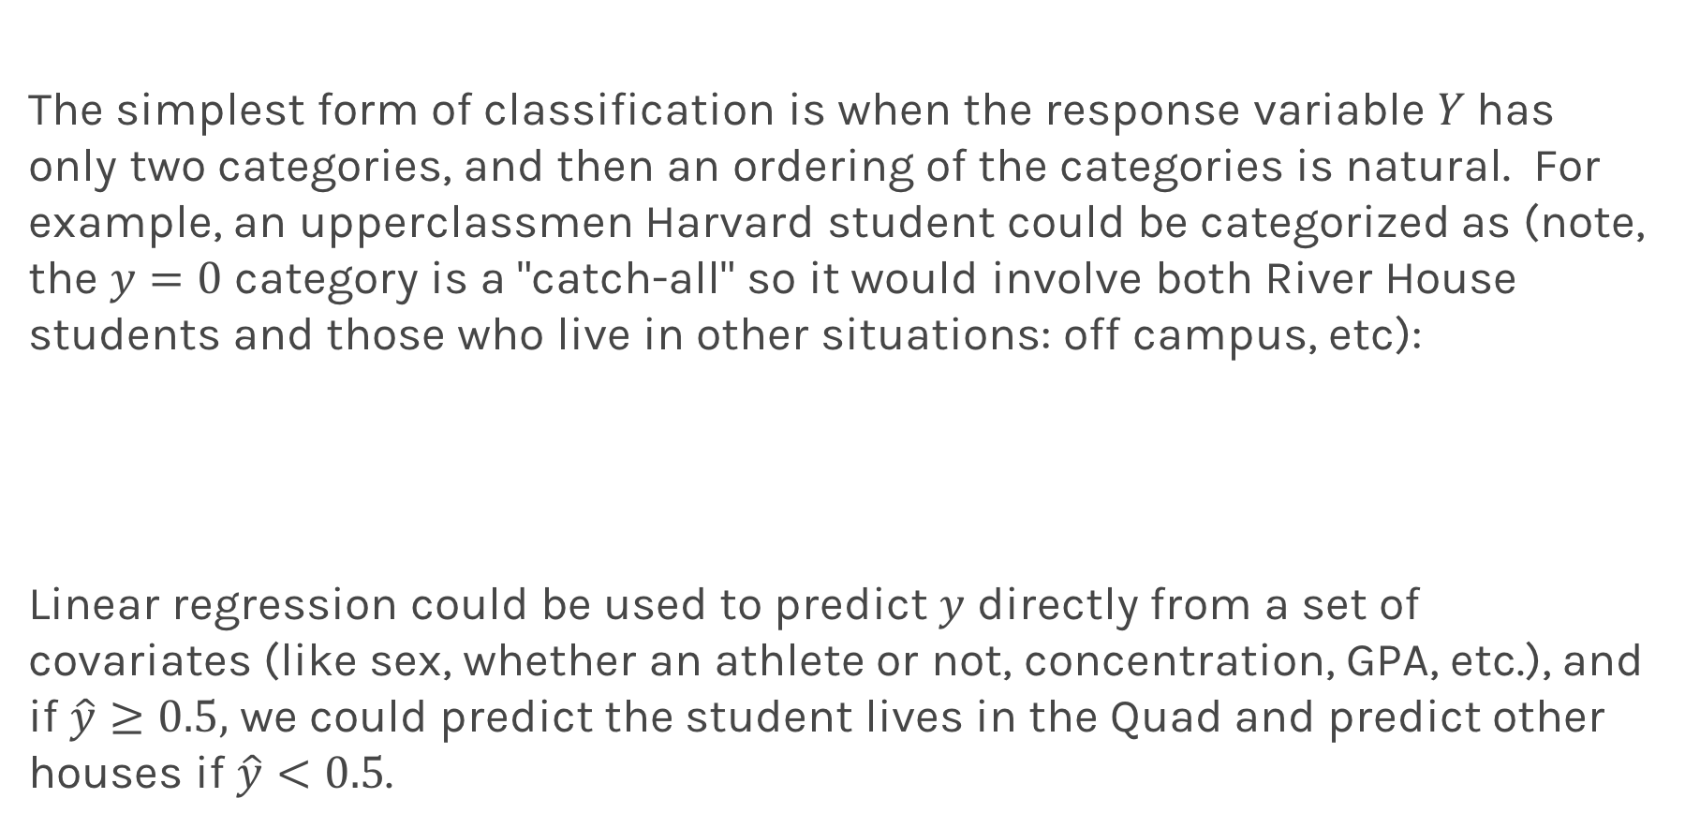
Even Simpler Classification Problem: Binary Response
The simplest form of classification is when the response variable $Y$has only two categories, and then an ordering of the categories is natural. For example, an upperclassmen Harvard student could be categorized as (note, the $y=0$ category is a "catch-all" so it would involve both River House students and those who live in other situations: off campus, etc):
Linear regression could be used to predict $y$ directly from a set of covariates (like sex, whether an athlete or not, concentration, GPA, etc.), and if $\hat{y}≥0.5,$ we could predict the student lives in the Quad and predict other houses if $\hat{y}<0.5$.

Slide 13
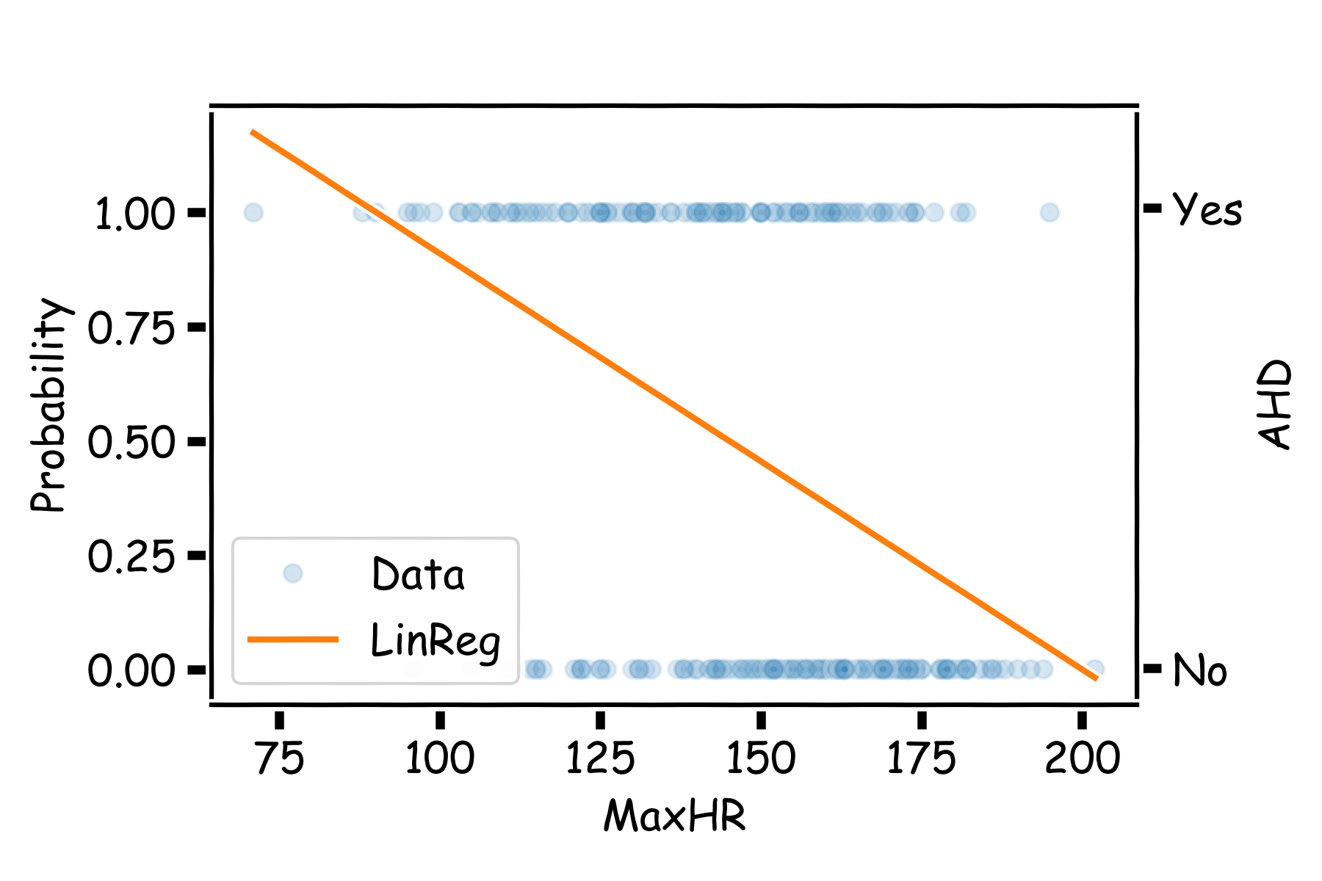
Even Simpler Classification Problem: Binary Response
What could go wrong with this linear regression model?
.

Slide 14
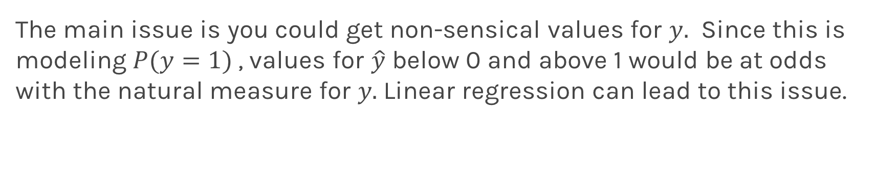
Even Simpler Classification Problem: Binary Response
The main issue is you could get non-sensical values for $y.$ Since this is modeling $P(y=1)$, values for $\hat{y}$ below 0 and above 1 would be at odds with the natural measure for $y.$Linear regression can lead to this issue.

Slide 15
Binary Response & Logistic Regression

Slide 16
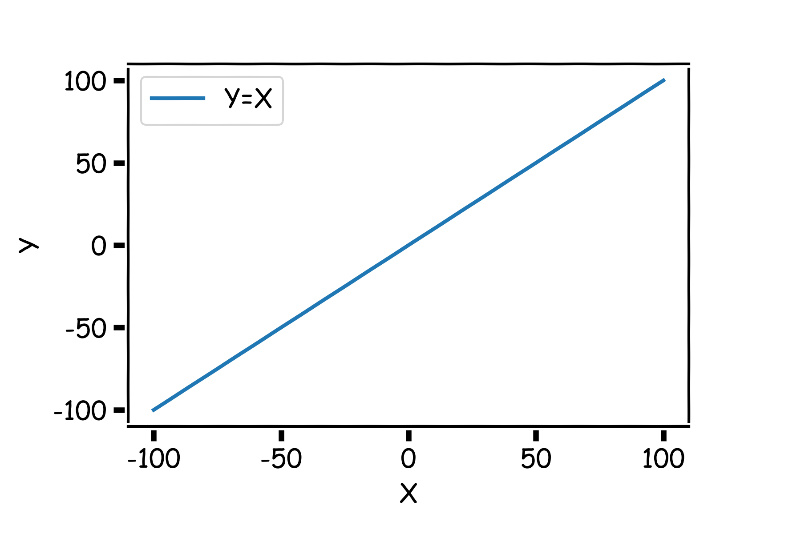
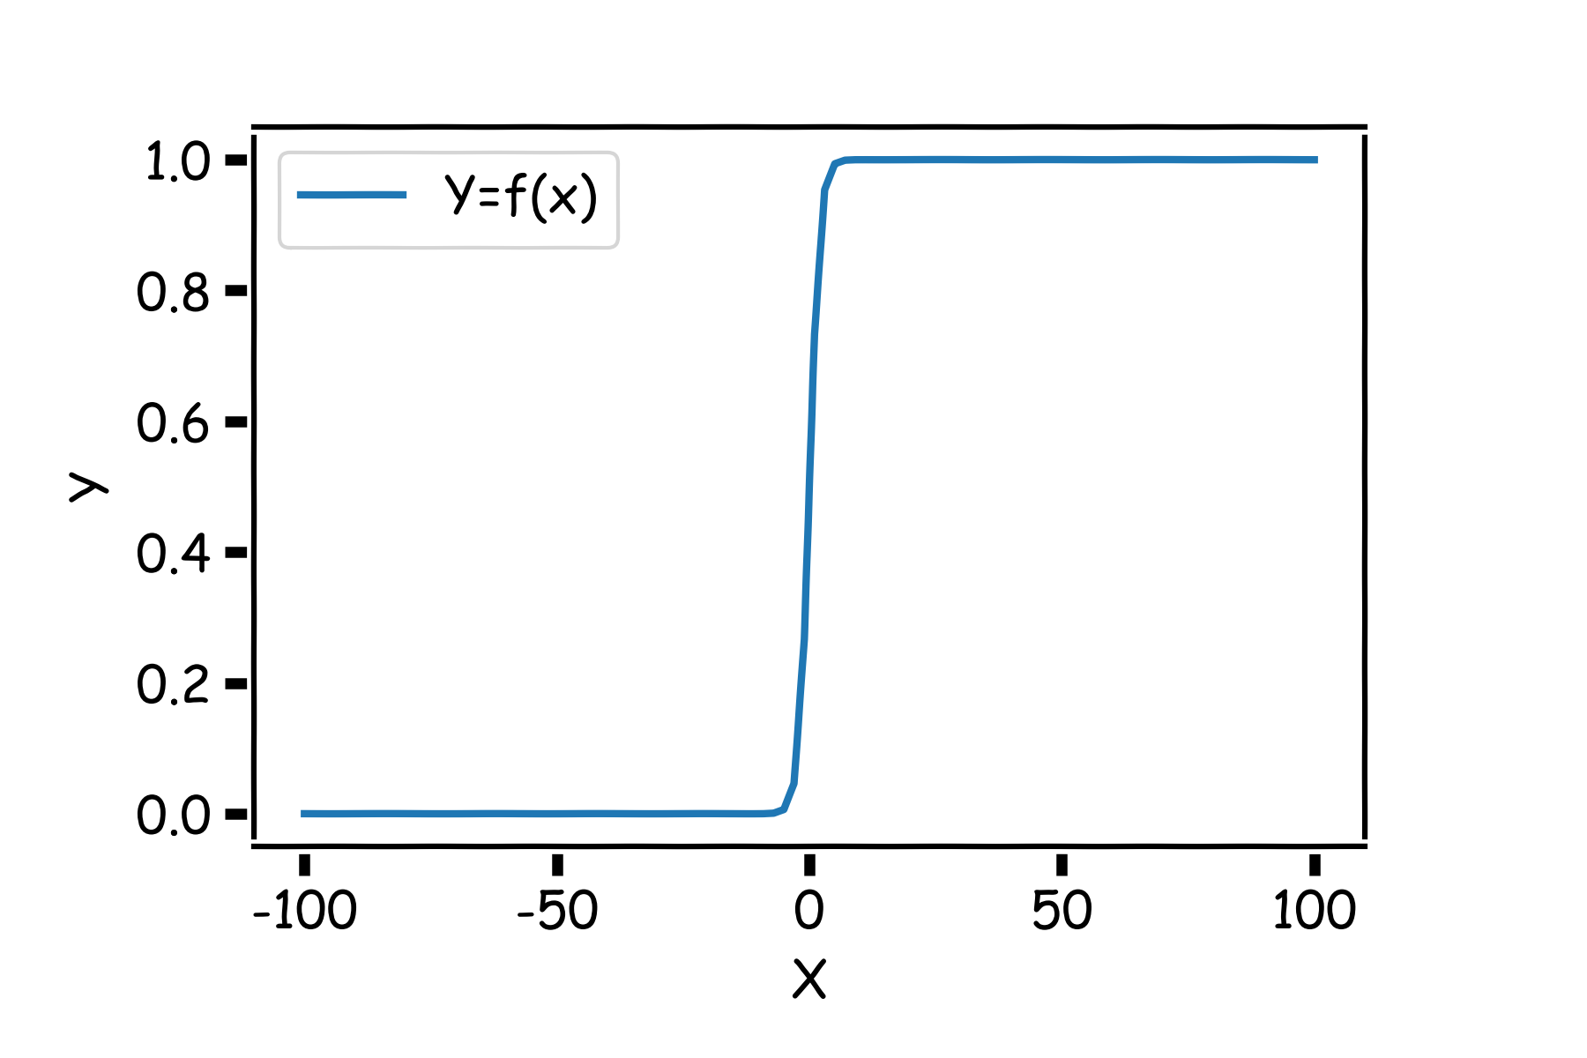
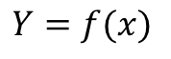
Pavlos Game #45
Think of a function that would do this for us
$$Y=f(x)$$

Slide 17
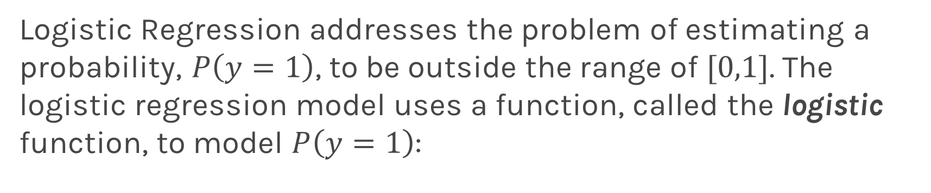
Logistic Regression
Logistic Regression addresses the problem of estimating a probability, $P\left(y=1\right)$, to be outside the range of $[0,1]$. The logistic regression model uses a function, called the logistic function, to model $P\left(y=1\right)$:

Slide 18
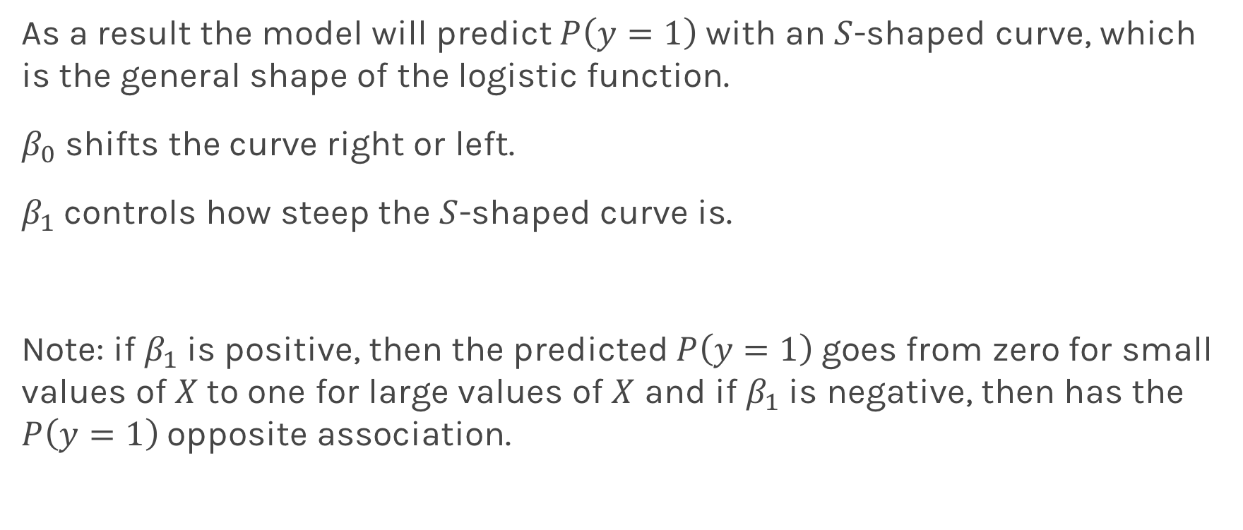
Logistic Regression
As a result the model will predict $P\left(y=1\right)$ with an $S$-shaped curve, which is the general shape of the logistic function.
$β_{0}$ shifts the curve right or left.
$β_{1}$controls how steep the $S$-shaped curve is.
Note: if $β_{1}$is positive, then the predicted $P\left(y=1\right)$goes from zero for small values of $X$to one for large values of $X$ and if $β_{1}$is negative, then has the $P\left(y=1\right)$opposite association.

Slide 19
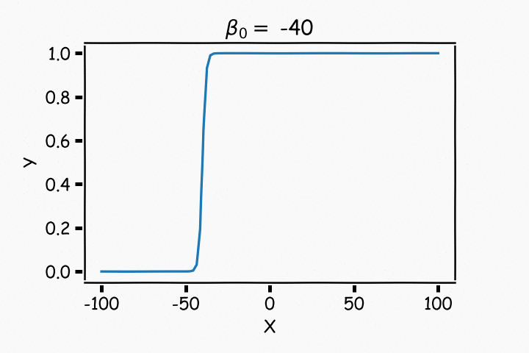
Logistic Regression

Slide 20
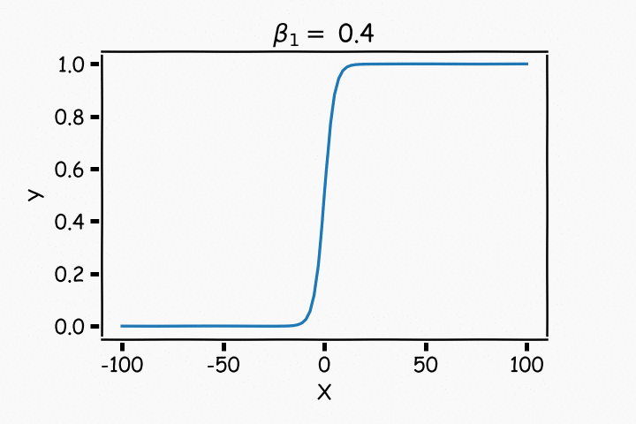
Logistic Regression

Slide 21
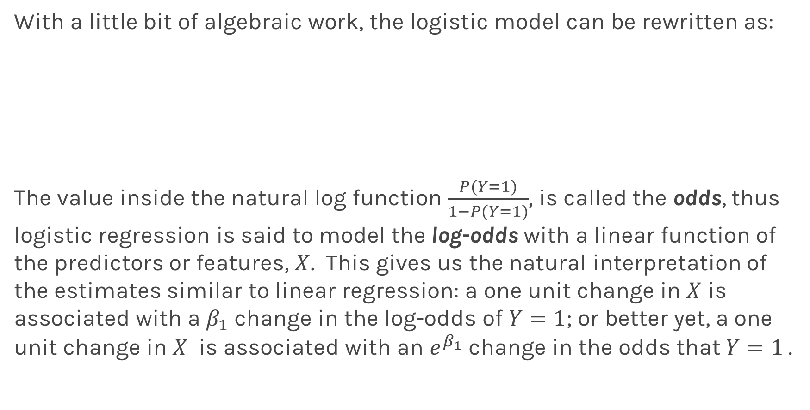
Logistic Regression
With a little bit of algebraic work, the logistic model can be rewritten as:
The value inside the natural log function $\frac{P(Y=1)}{1−P(Y=1)}$, is called the odds, thus logistic regression is said to model the log-odds with a linear function of the predictors or features, $X$. This gives us the natural interpretation of the estimates similar to linear regression: a one unit change in $X$ is associated with a $β_{1}$ change in the log-odds of $Y=1$; or better yet, a one unit change in $X$ is associated with an $e^{β_{1}}$ change in the odds that $Y=1$.

Slide 22
Estimating the Simple Logistic Model

Slide 23
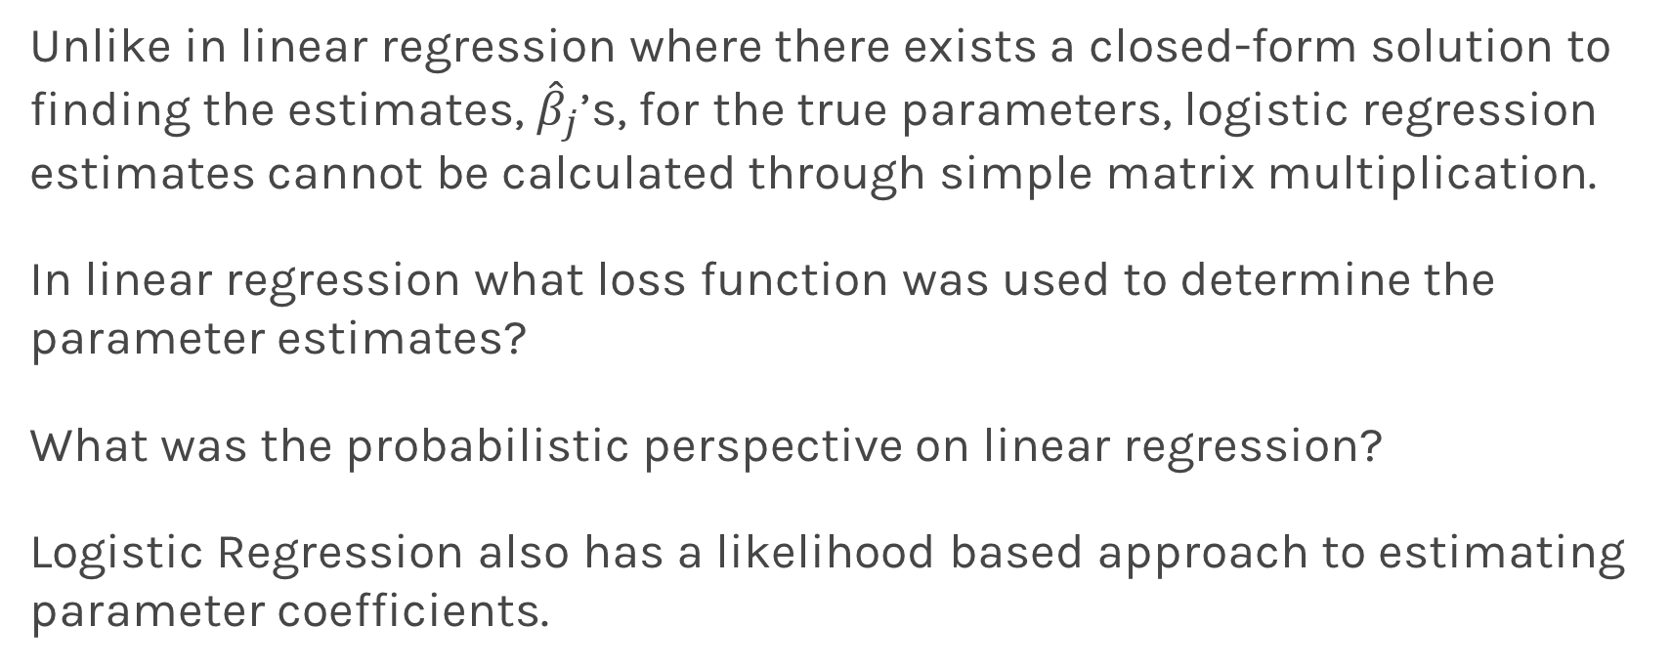
Estimation in Logistic Regression
Unlike in linear regression where there exists a closed-form solution to finding the estimates, ${\hat{β}}_{j}$’s, for the true parameters, logistic regression estimates cannot be calculated through simple matrix multiplication.
In linear regression what loss function was used to determine the parameter estimates?
What was the probabilistic perspective on linear regression?
Logistic Regression also has a likelihood based approach to estimating parameter coefficients.

Slide 24
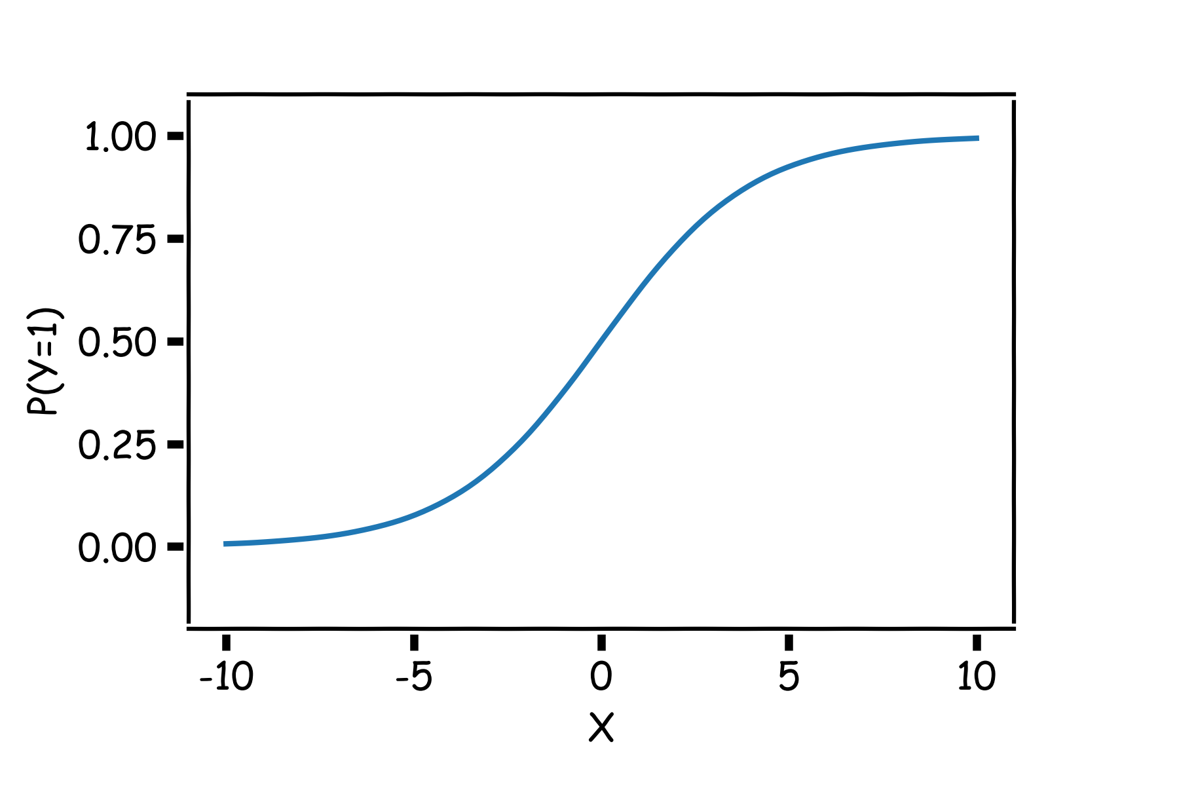
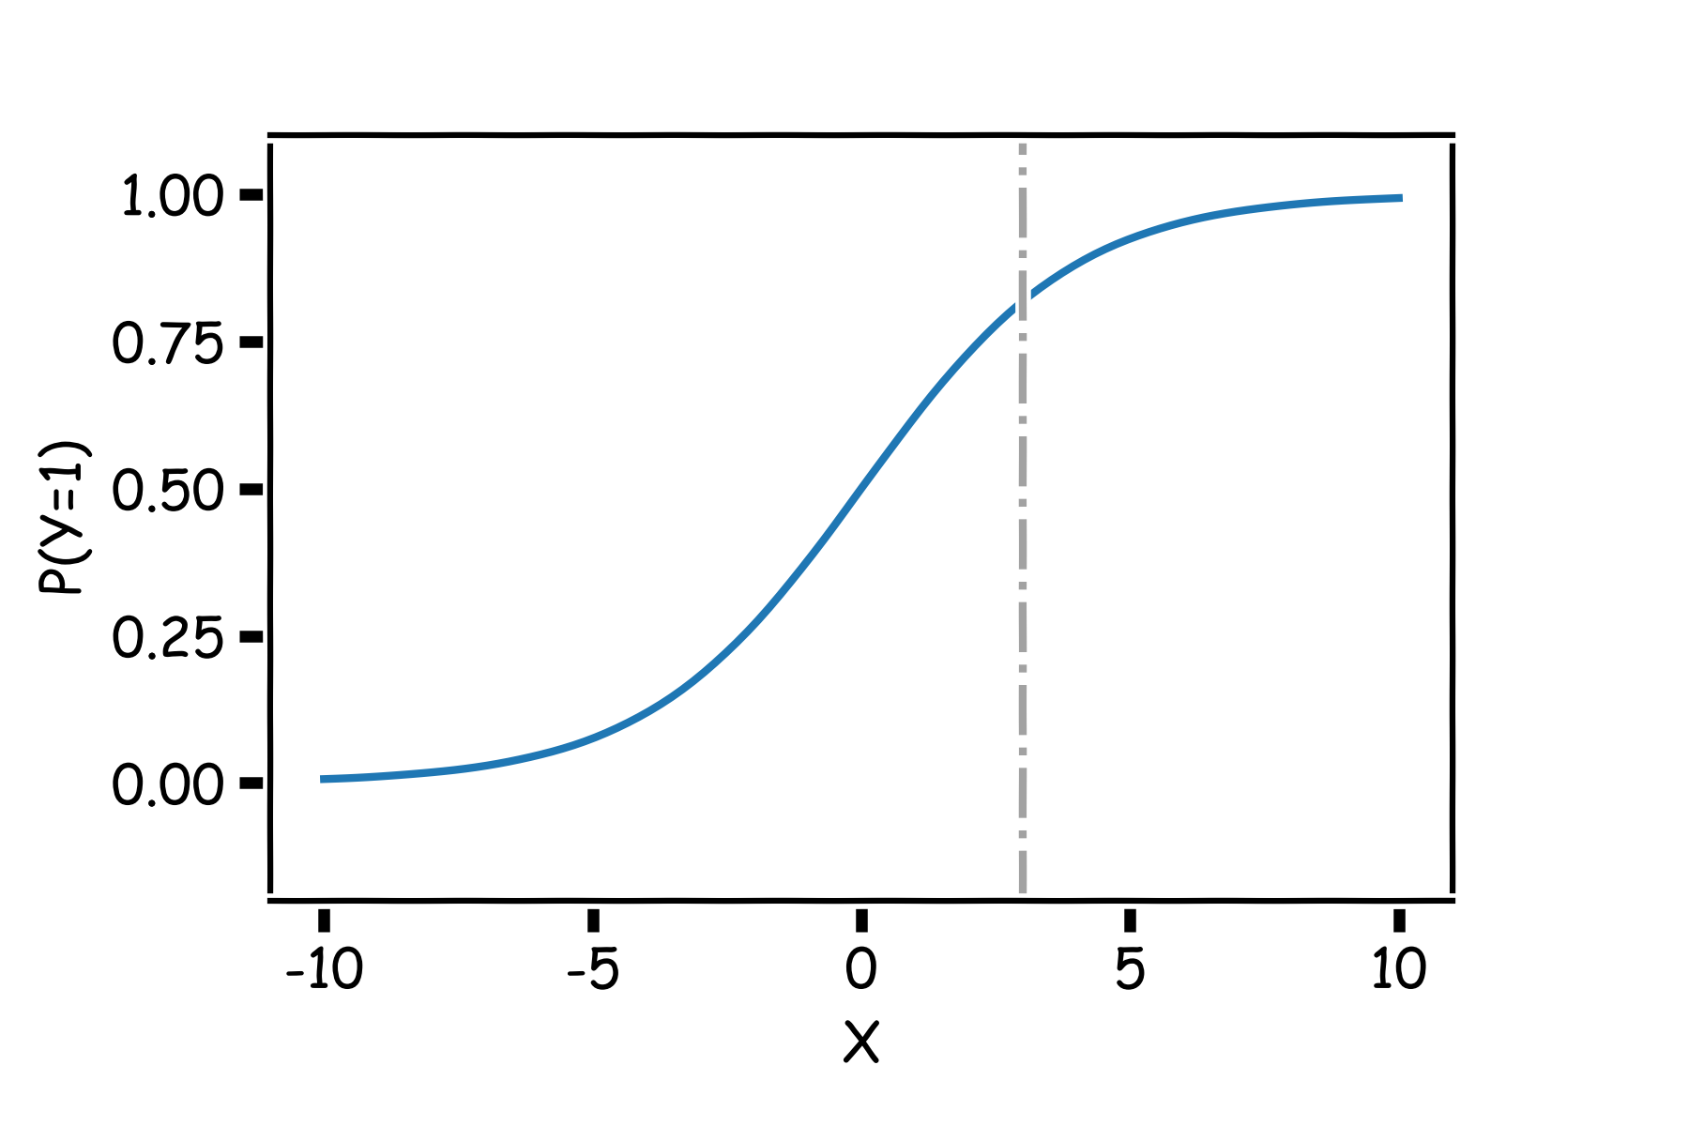
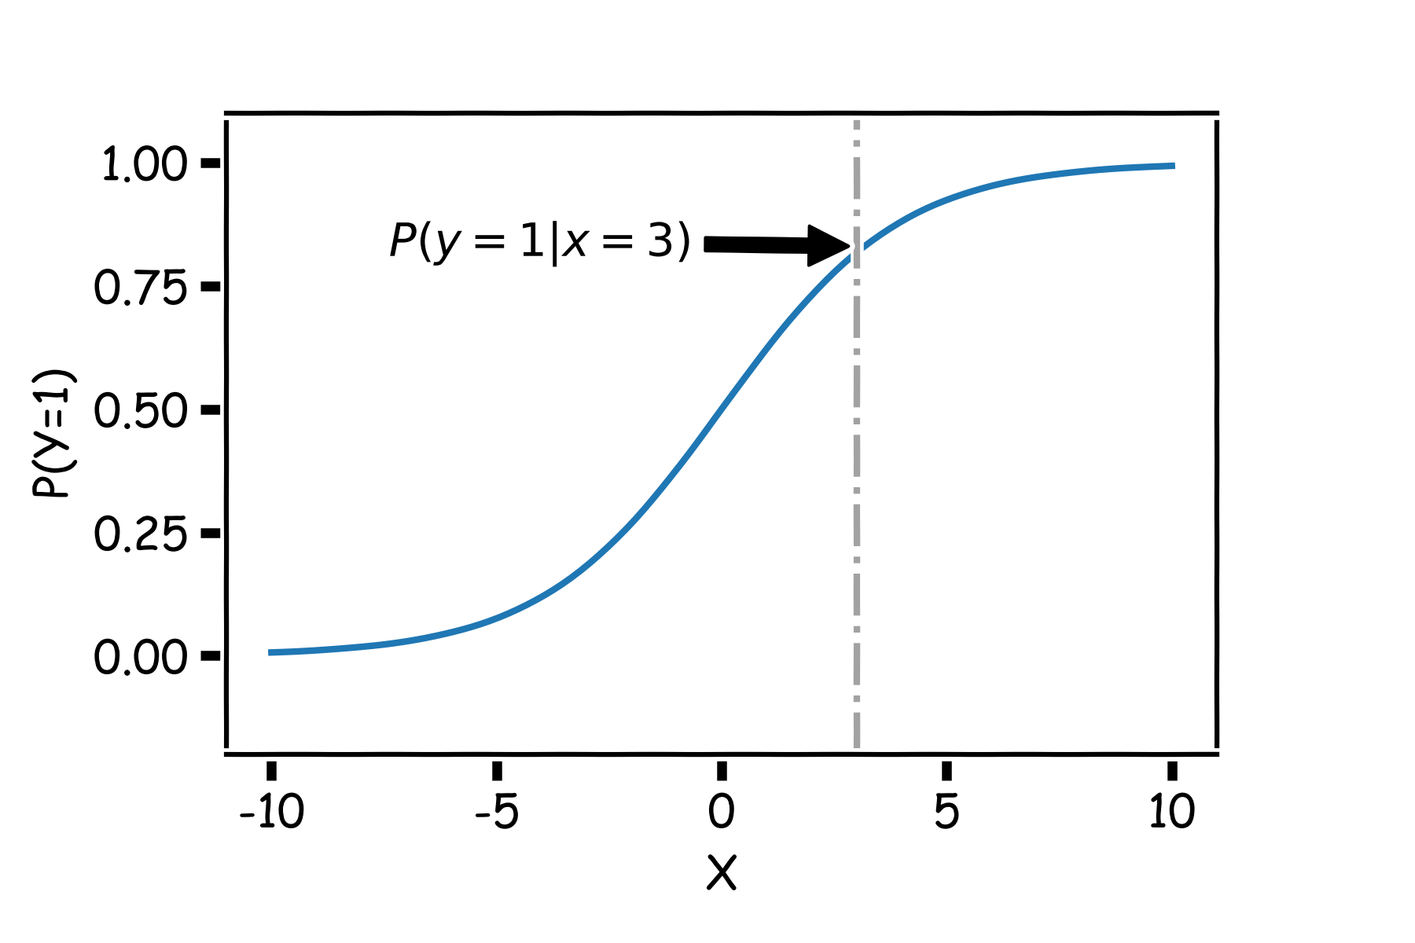
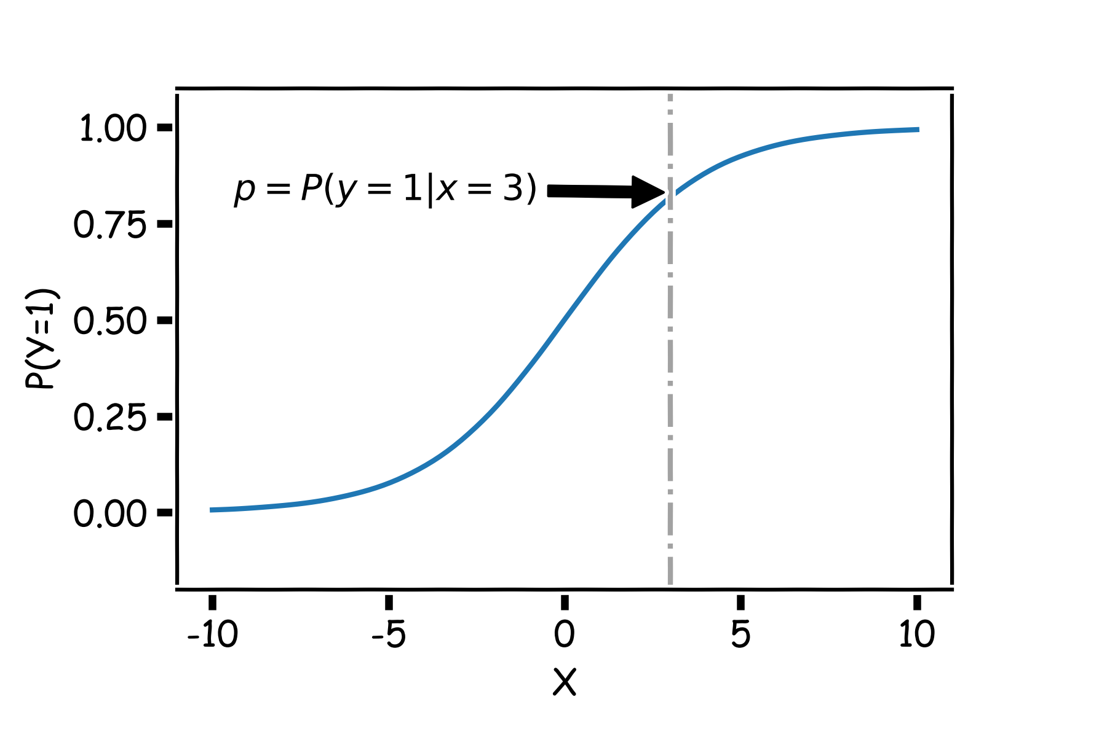
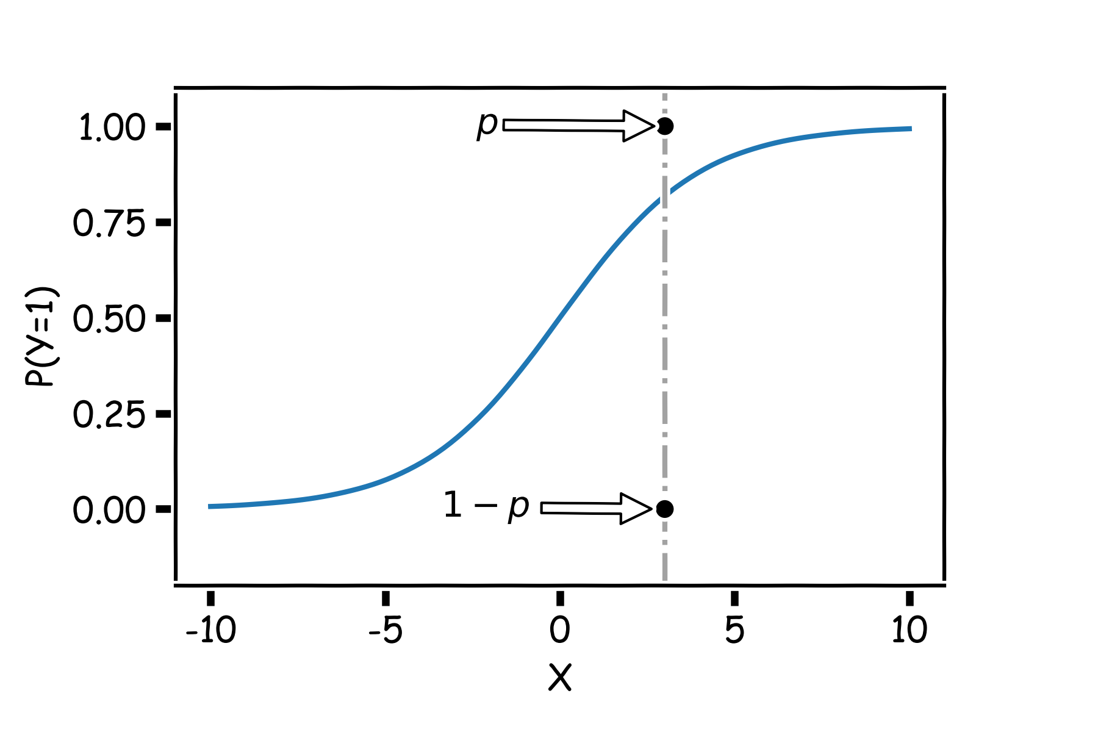
Estimation in Logistic Regression

Slide 25
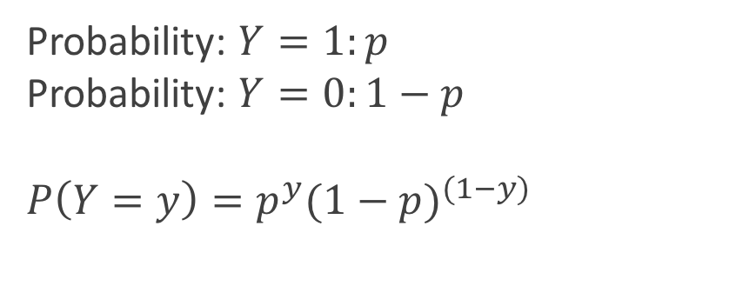
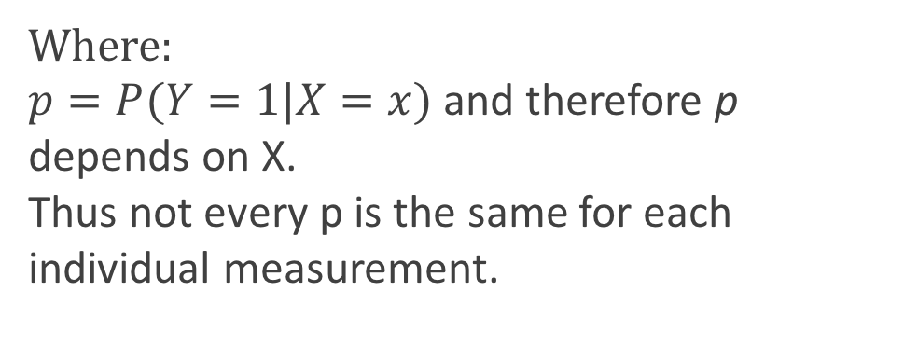
Estimation in Logistic Regression
Probability: $Y=1:p$
Probability: $Y=0:1−p$
$${P\left(Y=y\right)=p}^{y}{(1−p)}^{(1−y)}$$
Where:
$p=P(Y=1|X=x)$ and therefore p depends on X.
Thus not every p is the same for each individual measurement.

Slide 26
Likelihood
The likelihood of a single observation for p given x and y is:
Given the observations are independent, what is the likelihood function for p?

Slide 27
Likelihood
How do we maximize this?
Take the log and differentiate!
But jeeze does this look messy?! It will not necessarily have a closed form solution? So how do we determine the parameter estimates? Through an iterative approach (we will talk more about it next lecture).

Slide 28
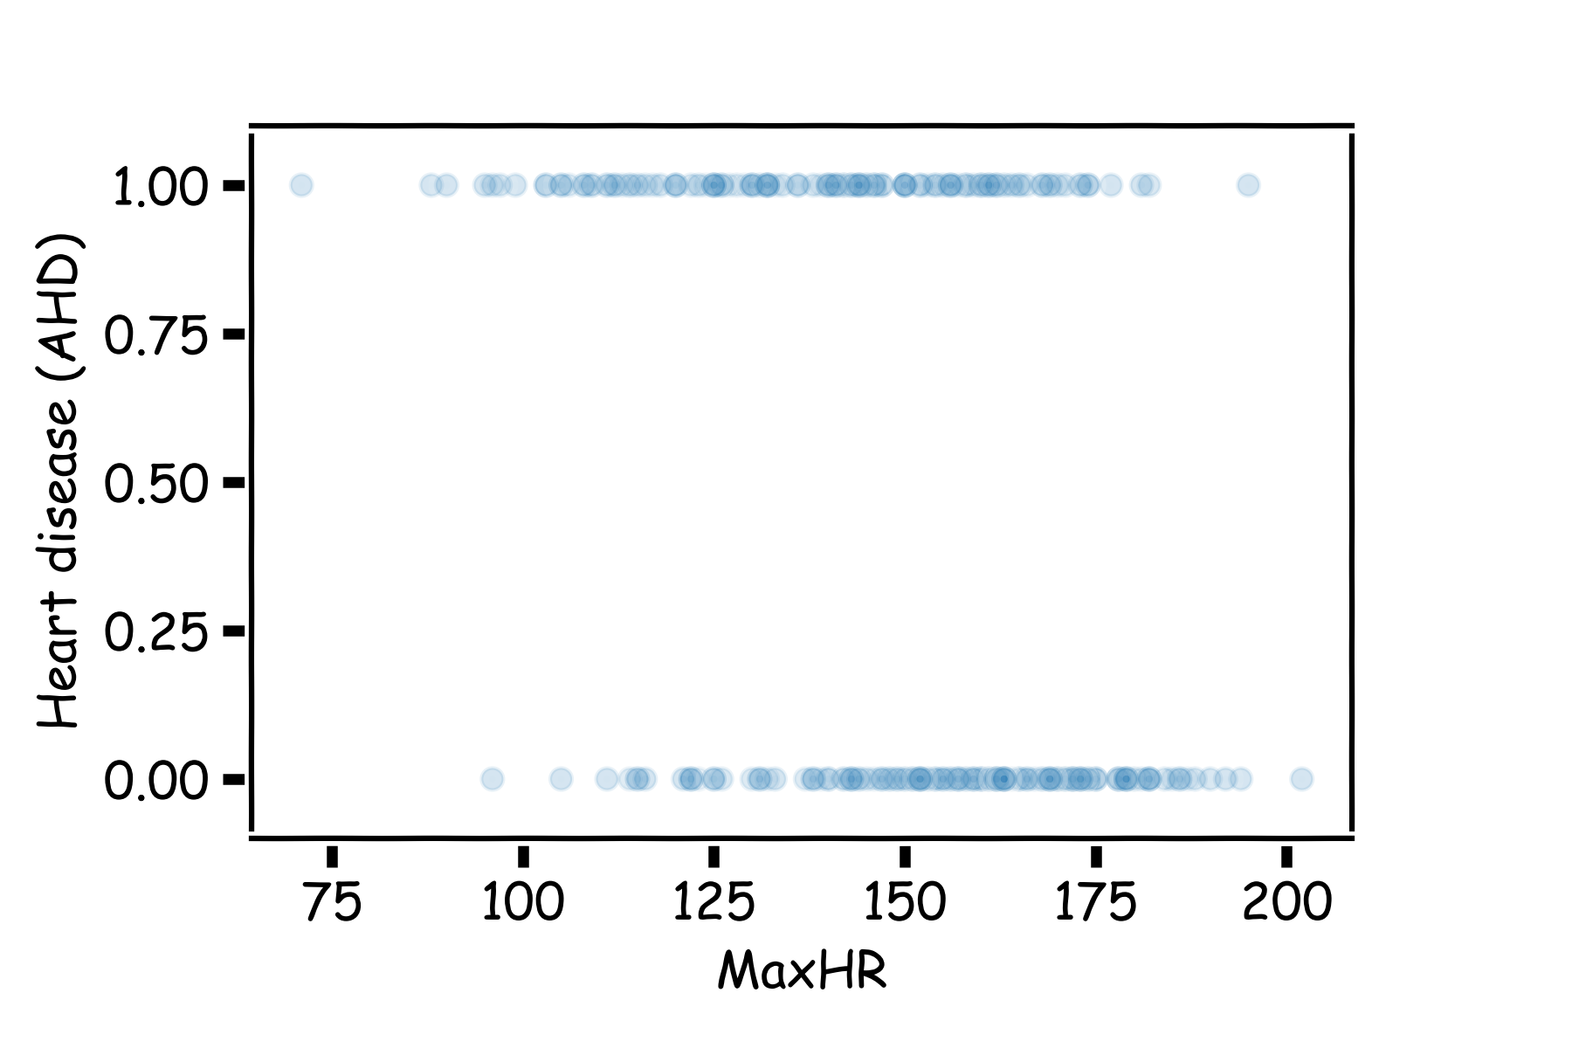
Heart Data: logistic estimation
We'd like to predict whether or not a person has a heart disease. And we'd like to make this prediction, for now, just based on the MaxHR.
How should we visualize these data?

Slide 29
Heart Data: logistic estimation
There are various ways to fit a logistic model to this data set in Python. The most straightforward in sklearn is via linear_model.LogisticRegression. A little bit of preprocessing work may need to be done first.

Slide 30
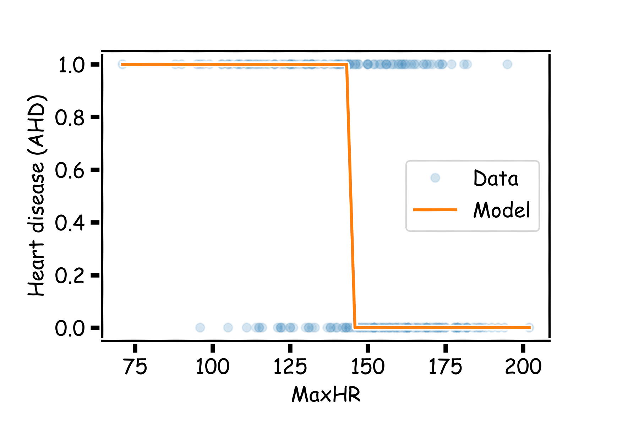
Heart Data: logistic estimation

Slide 31
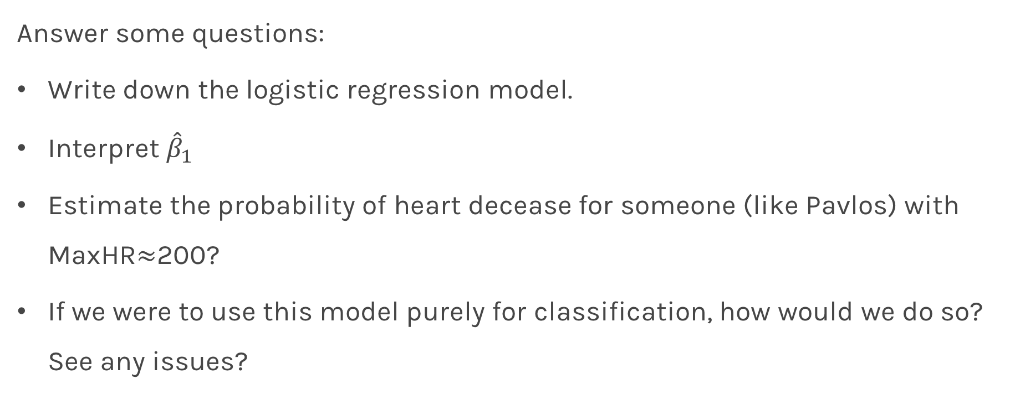
Heart Data: logistic estimation
Answer some questions:
Write down the logistic regression model.
Interpret ${\hat{β}}_{1}$
Estimate the probability of heart decease for someone (like Pavlos) with MaxHR$≈$200?
If we were to use this model purely for classification, how would we do so? See any issues?

Slide 32
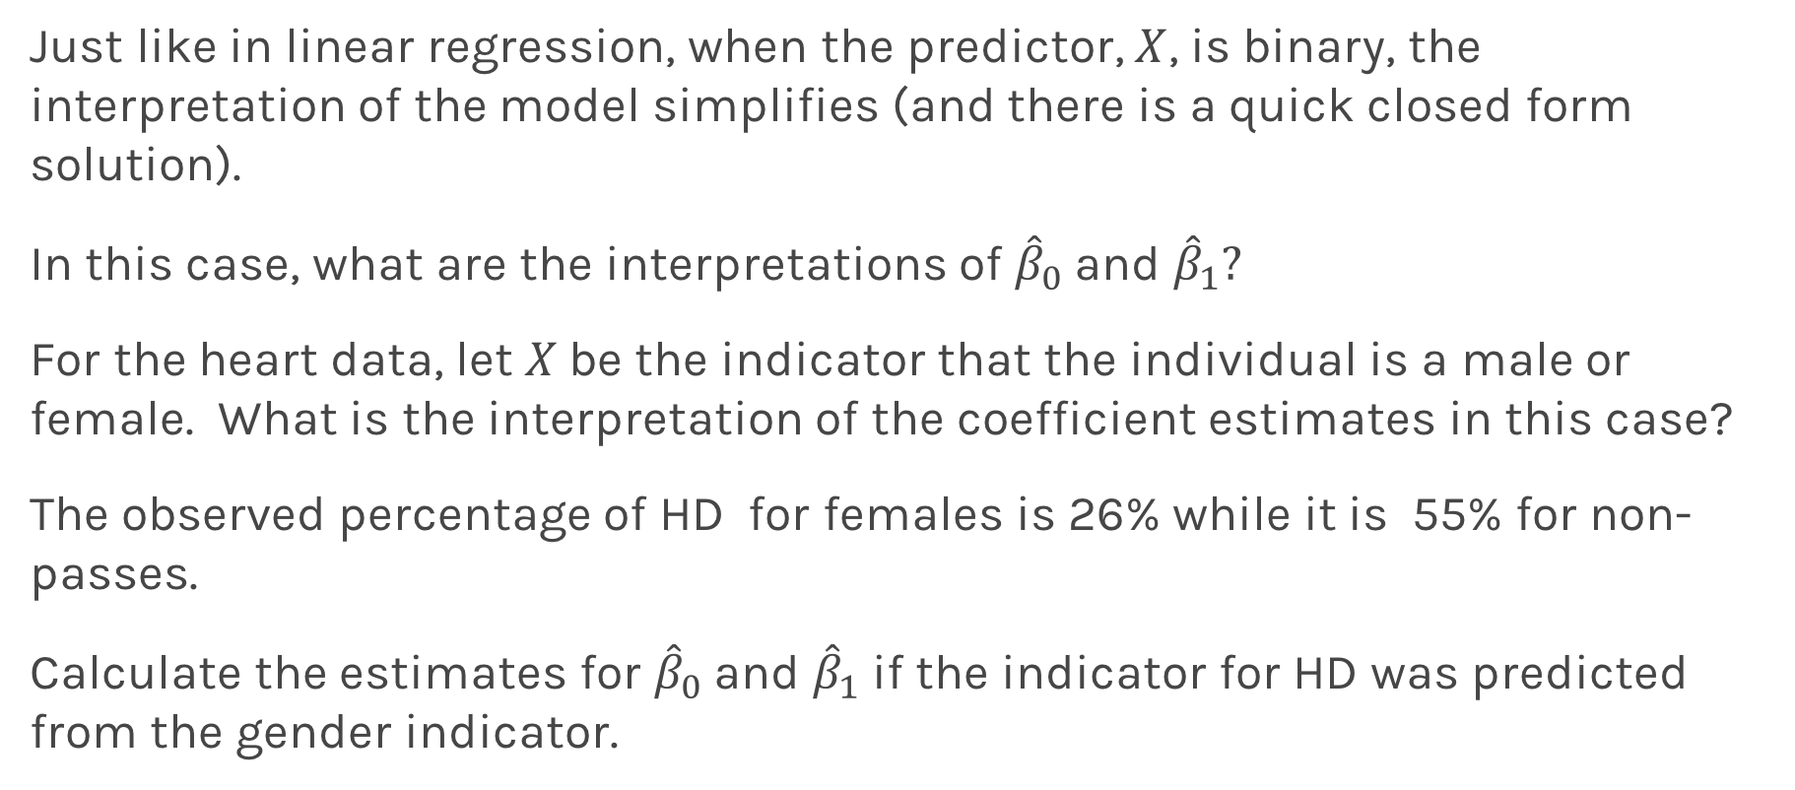
Categorical Predictors
Just like in linear regression, when the predictor, $X$, is binary, the interpretation of the model simplifies (and there is a quick closed form solution).
In this case, what are the interpretations of ${\hat{β}}_{0}$and ${\hat{β}}_{1}?$
For the heart data, let $X$be the indicator that the individual is a male or female. What is the interpretation of the coefficient estimates in this case?
The observed percentage of HD for females is 26% while it is 55% for non-passes.
Calculate the estimates for ${\hat{β}}_{0}$and ${\hat{β}}_{1}$ if the indicator for HD was predicted from the gender indicator.

Slide 33
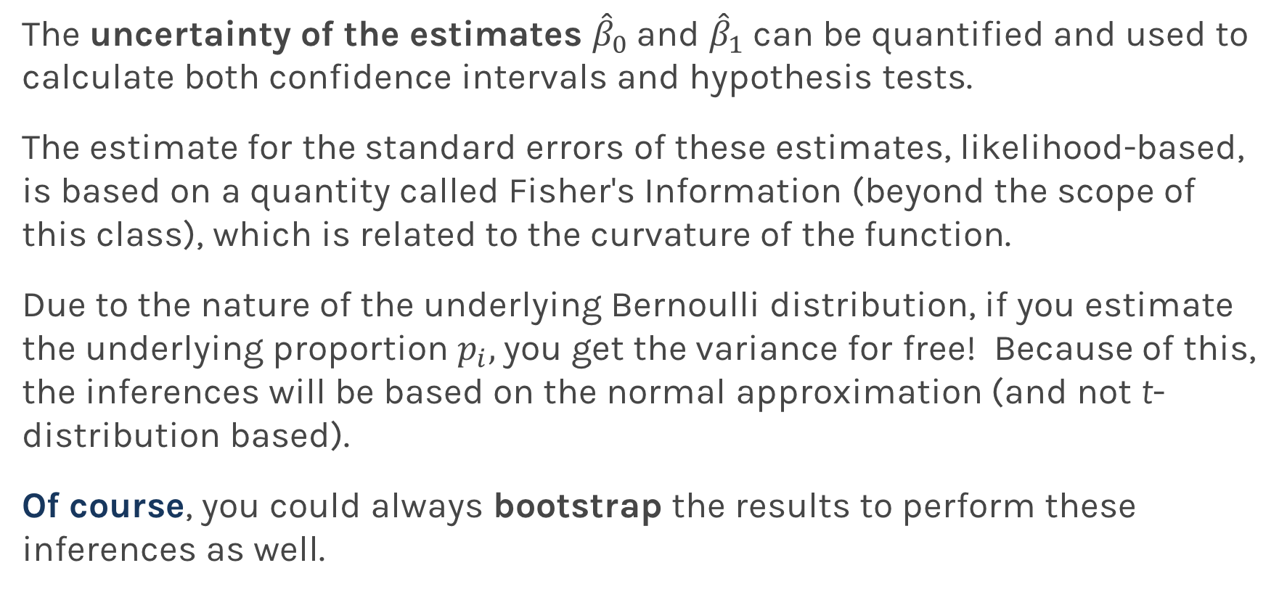
Statistical Inference in Logistic Regression
The uncertainty of the estimates ${\hat{β}}_{0}$and ${\hat{β}}_{1}$ can be quantified and used to calculate both confidence intervals and hypothesis tests.
The estimate for the standard errors of these estimates, likelihood-based, is based on a quantity called Fisher's Information (beyond the scope of this class), which is related to the curvature of the function.
Due to the nature of the underlying Bernoulli distribution, if you estimate the underlying proportion $p_{i},$you get the variance for free! Because of this, the inferences will be based on the normal approximation (and not t-distribution based).
Of course, you could always bootstrap the results to perform these inferences as well.

Slide 34
Classification using the Logistic Model

Slide 35
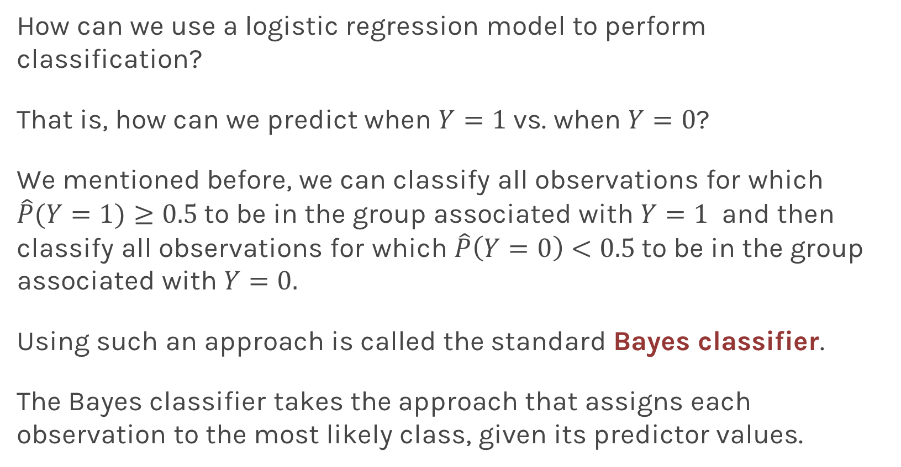
Using Logistic Regression for Classification
How can we use a logistic regression model to perform classification?
That is, how can we predict when $Y=1$ vs. when $Y=0$?
We mentioned before, we can classify all observations for which $\hat{P}(Y=1)≥0.5$to be in the group associated with $Y=1$ and then classify all observations for which $\hat{P}\left(Y=0\right)<0.5$to be in the group associated with $Y=0.$
Using such an approach is called the standard Bayes classifier.
The Bayes classifier takes the approach that assigns each observation to the most likely class, given its predictor values.

Slide 36
Using Logistic Regression for Classification
When will this Bayes classifier be a good one? When will it be a poor one?
The Bayes classifier is the one that minimizes the overall classification error rate. That is, it minimizes:
Is this a good Loss function to minimize? Why or why not?
The Bayes classifier may be a poor indicator within a group. Think about the Heart Data scatter plot...

Slide 37
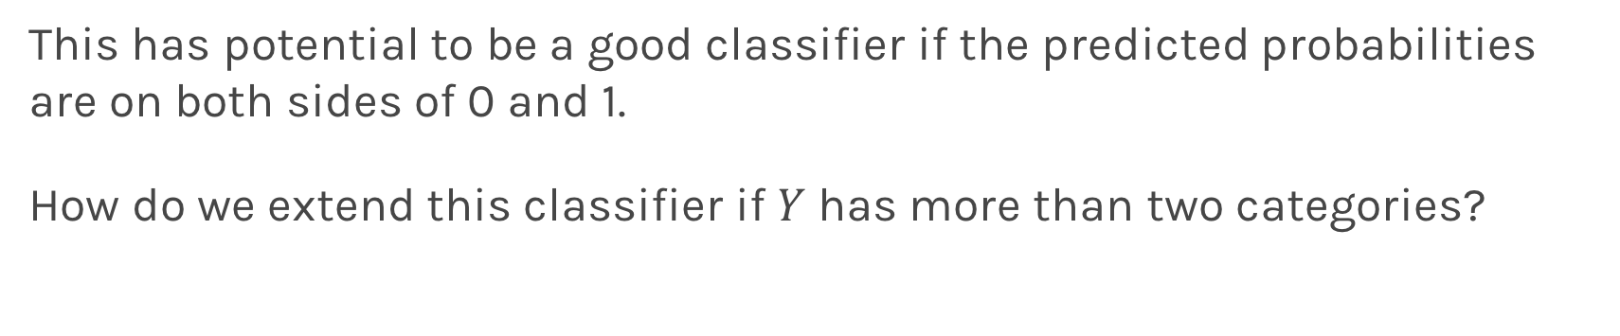
Using Logistic Regression for Classification
This has potential to be a good classifier if the predicted probabilities are on both sides of 0 and 1.
How do we extend this classifier if $Y$ has more than two categories?

Slide 38
Extending the Logistic Model

Slide 39
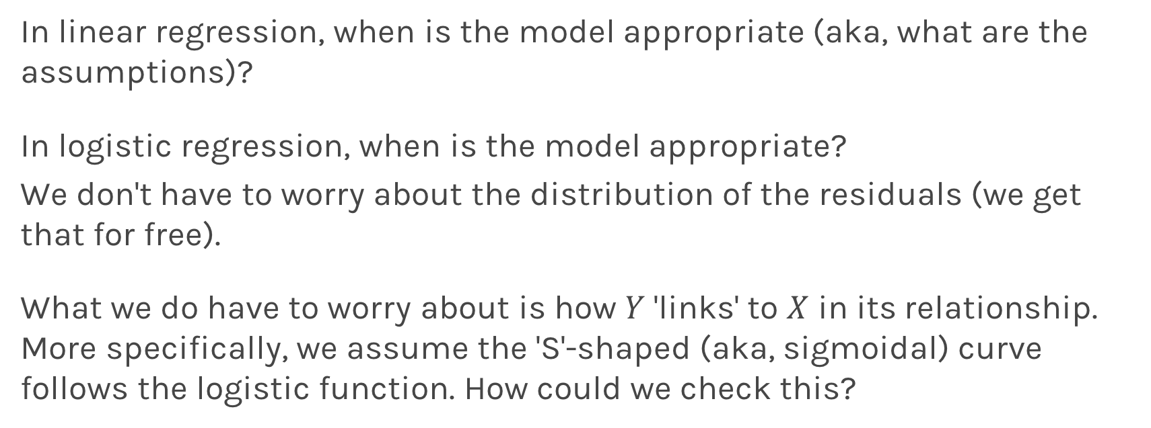
Model Diagnostics in Logistic Regression
In linear regression, when is the model appropriate (aka, what are the assumptions)?
In logistic regression, when is the model appropriate?
We don't have to worry about the distribution of the residuals (we get that for free).
What we do have to worry about is how $Y$ 'links' to $X$ in its relationship. More specifically, we assume the 'S'-shaped (aka, sigmoidal) curve follows the logistic function. How could we check this?

Slide 40
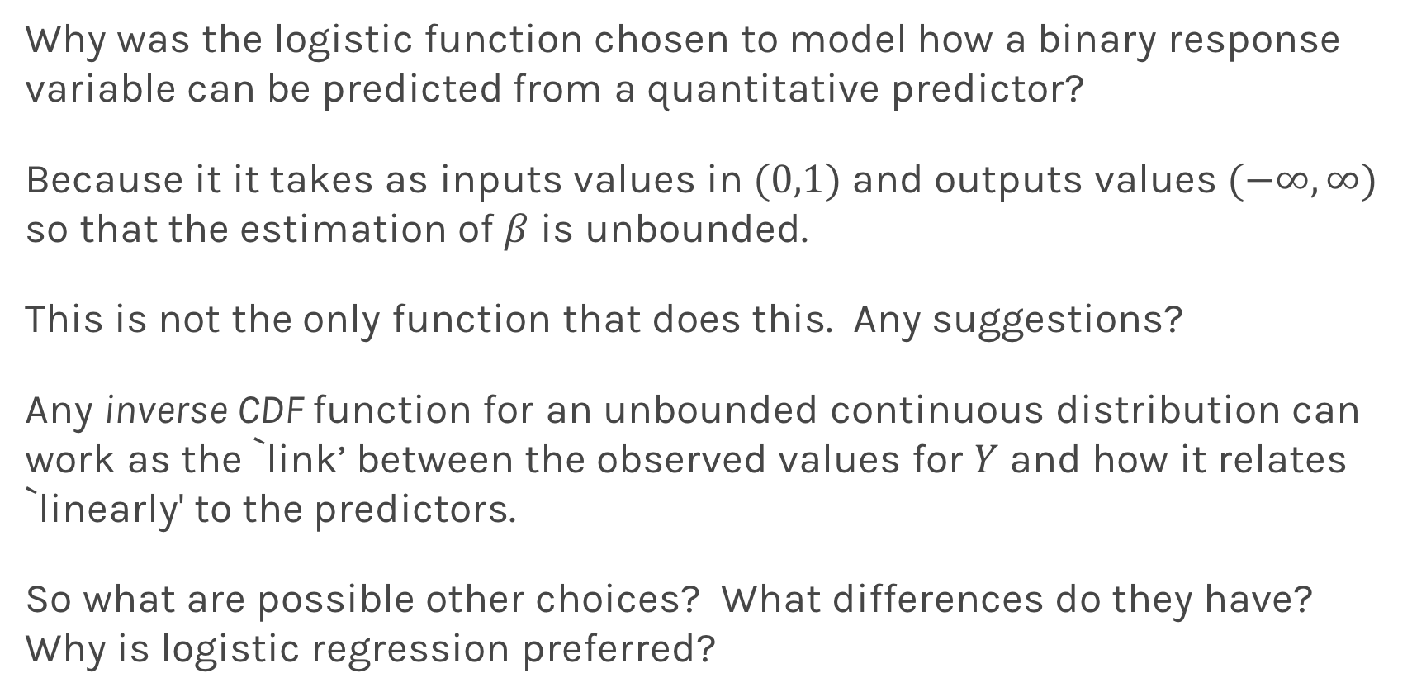
Alternatives to logistic regression
Why was the logistic function chosen to model how a binary response variable can be predicted from a quantitative predictor?
Because it it takes as inputs values in $(0,1)$ and outputs values $(−∞,∞)$ so that the estimation of $β$ is unbounded.
This is not the only function that does this. Any suggestions?
Any inverse CDF function for an unbounded continuous distribution can work as the `link’ between the observed values for $Y$ and how it relates `linearly' to the predictors.
So what are possible other choices? What differences do they have? Why is logistic regression preferred?

Slide 41
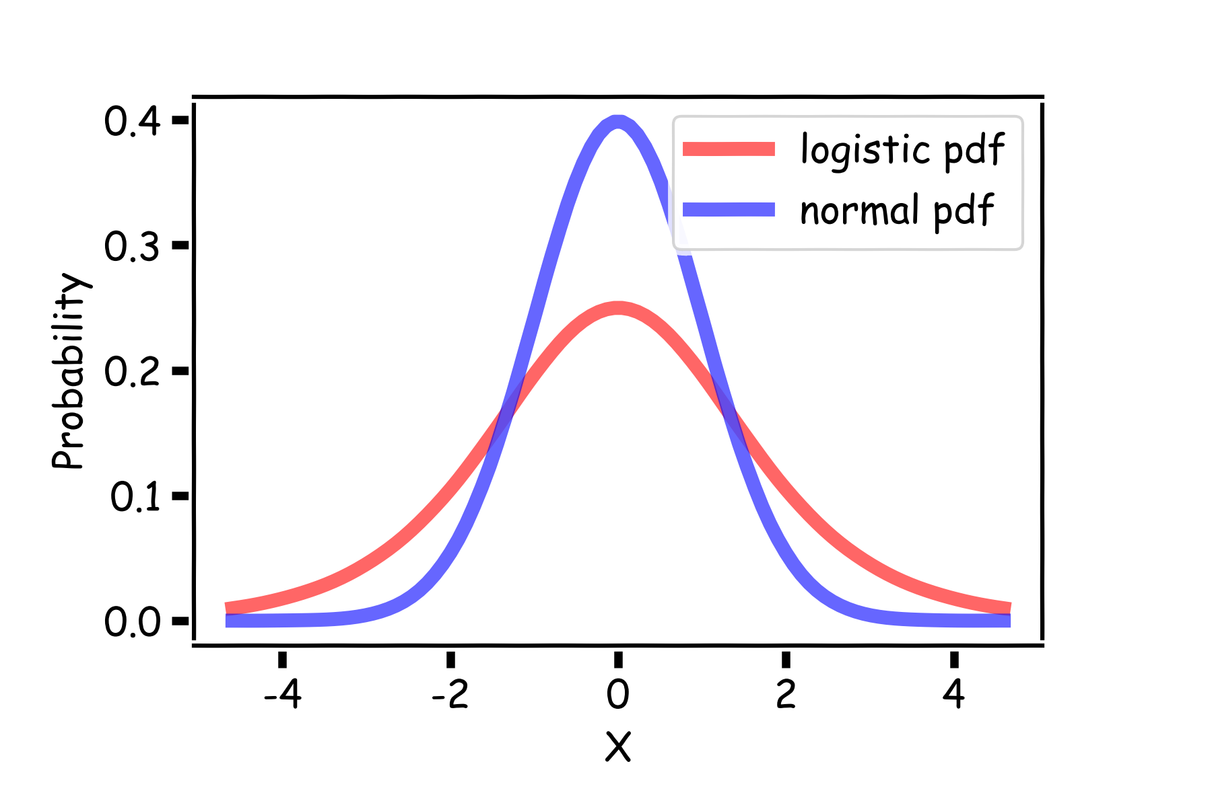
Logistic vs Normal pdf
The choice of link function determines the shape of the S’ shape. Let's compare the pdf's for the Logistic and Normal distributions (called a ’probit’ model, econometricians love these):
So what?

Slide 42
Logistic vs Normal pdf
Choosing a distribution with longer tails will make for a shape that asymptotes more slowly (likely a good thing for model fitting).

Slide 43
Multiple Logistic Regression

Slide 44
Multiple Logistic Regression
It is simple to illustrate examples in logistic regression when there is just one predictors variable.
But the approach ‘easily’ generalizes to the situation where there are multiple predictors.
A lot of the same details as linear regression apply to logistic regression. Interactions can be considered. Multicollinearity is a concern. So is overfitting. Etc...
So how do we correct for such problems?
Regularization and checking though train, test, and cross-validation!
We will get into the details of this, along with other extensions of logistic regression, in the next lecture.

Slide 45
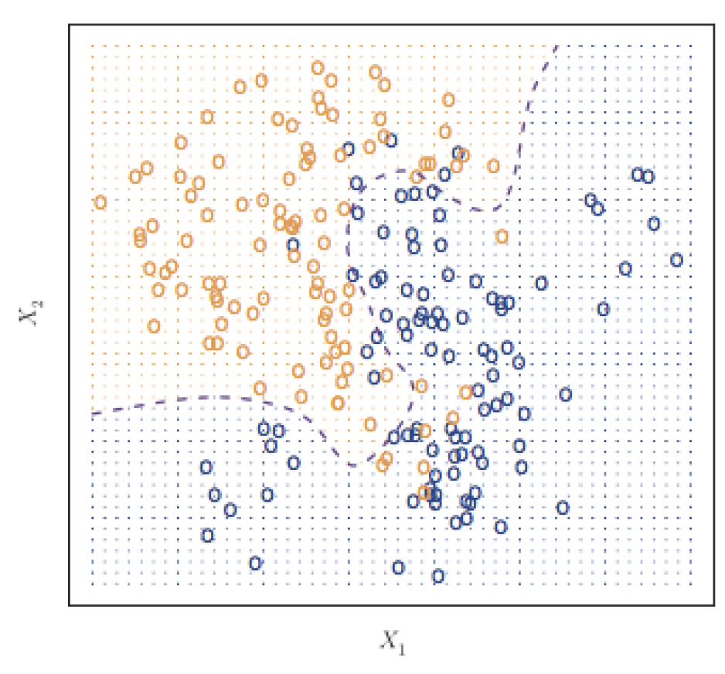
Classifier with two predictors
How can we estimate a classifier, based on logistic regression, for the following plot?

Slide 46
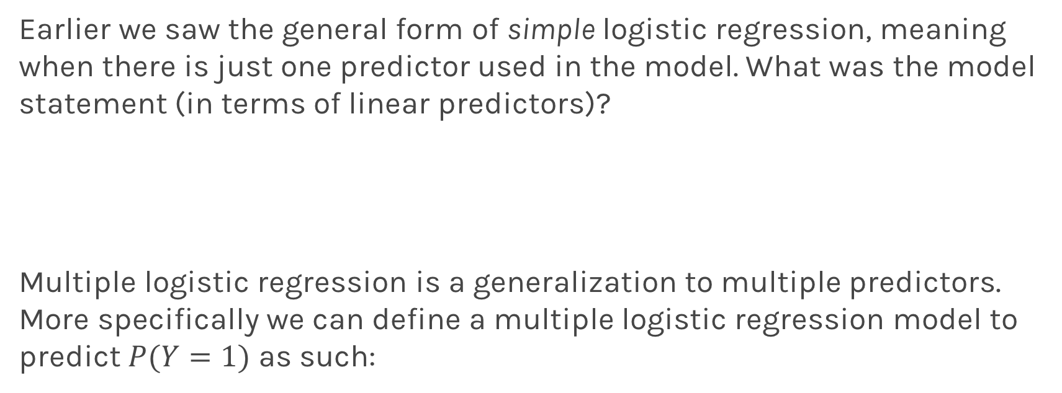
Multiple Logistic Regression
Earlier we saw the general form of simple logistic regression, meaning when there is just one predictor used in the model. What was the model statement (in terms of linear predictors)?
Multiple logistic regression is a generalization to multiple predictors. More specifically we can define a multiple logistic regression model to predict $P(Y=1)$ as such:

Slide 47
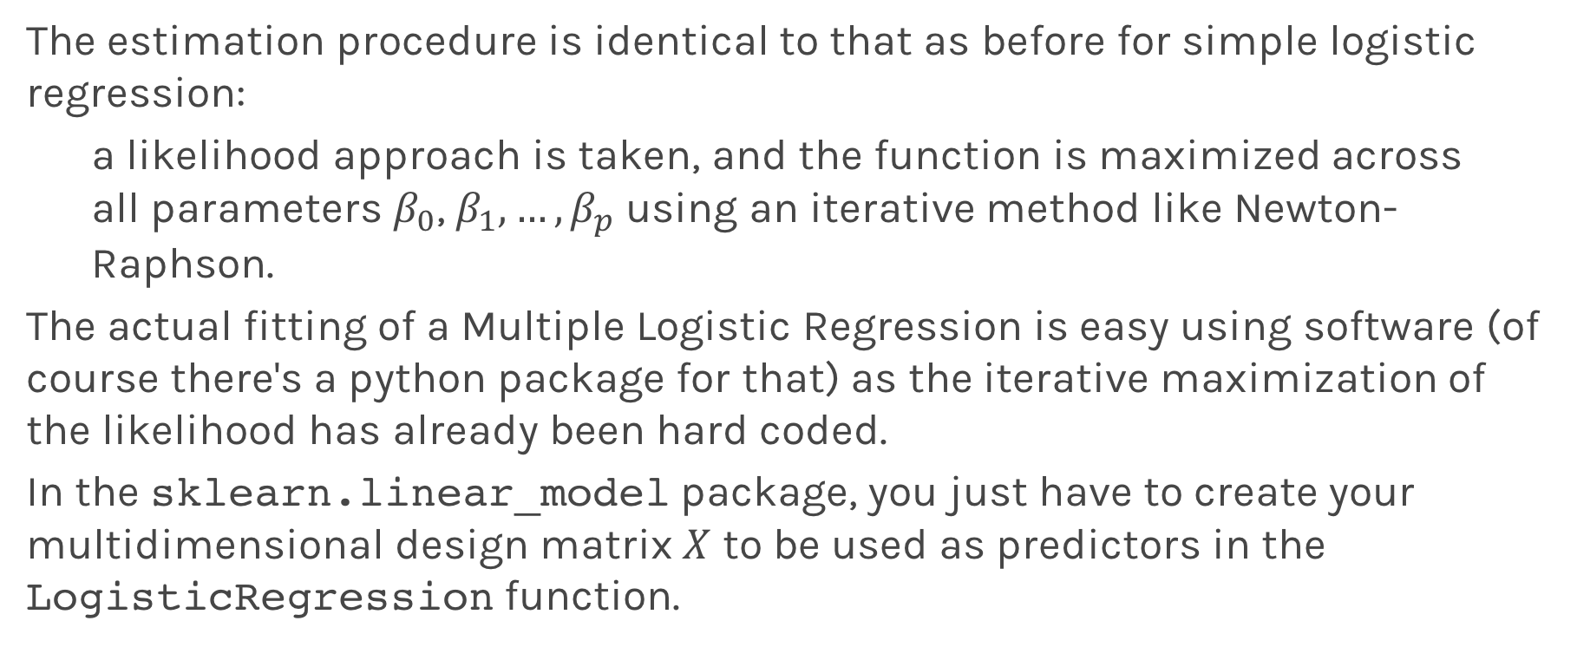
Fitting Multiple Logistic Regression
The estimation procedure is identical to that as before for simple logistic regression:
a likelihood approach is taken, and the function is maximized across all parameters $β_{0}$, $β_{1},…,β_{p}$ using an iterative method like Newton- Raphson.
The actual fitting of a Multiple Logistic Regression is easy using software (of course there's a python package for that) as the iterative maximization of the likelihood has already been hard coded.
In the sklearn.linear_model package, you just have to create your multidimensional design matrix $X$ to be used as predictors in the LogisticRegression function.

Slide 48
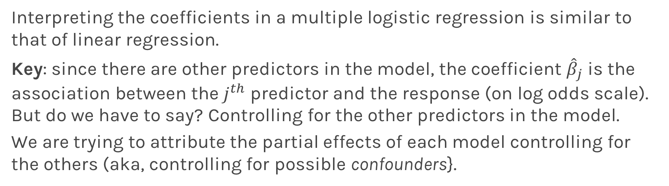
Interpretation of Multiple Logistic Regression
Interpreting the coefficients in a multiple logistic regression is similar to that of linear regression.
Key: since there are other predictors in the model, the coefficient ${\hat{β}}_{j}$ is the association between the $j^{th}$ predictor and the response (on log odds scale). But do we have to say? Controlling for the other predictors in the model.
We are trying to attribute the partial effects of each model controlling for the others (aka, controlling for possible confounders}.

Slide 49
Interpreting Multiple Logistic Regression: an Example
Let's get back to the Heart Data. We are attempting to predict whether someone has HD based on MaxHR and whether the person is a female or male. The simultaneous effect of these two predictors can be brought into one model.
Recall from earlier we had the following estimated models:

Slide 50
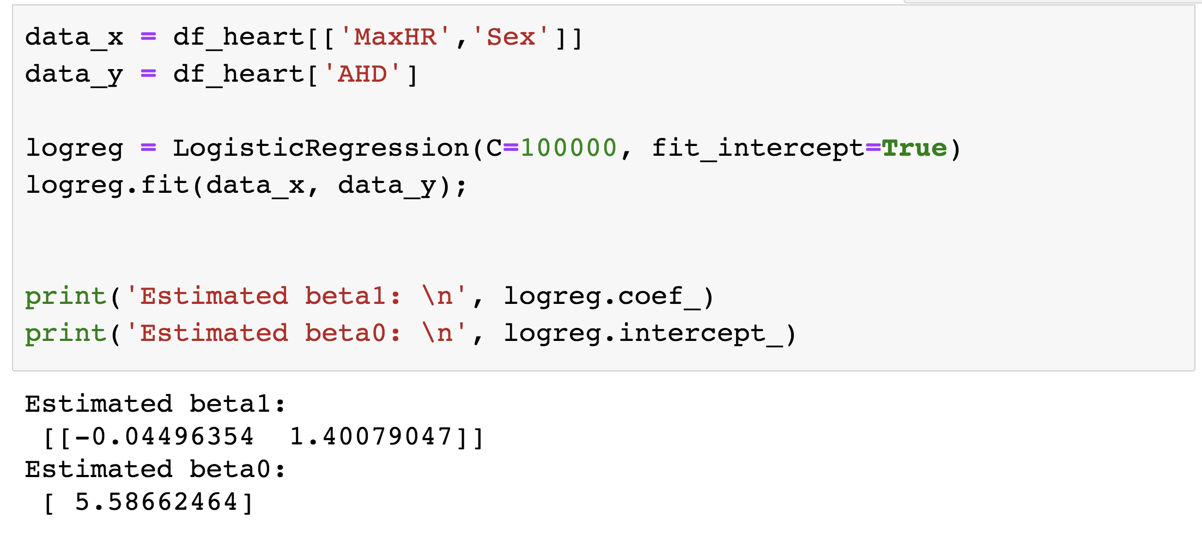
Interpreting Multiple Logistic Regression: an Example
The results for the multiple logistic regression model are:

Slide 51
Some questions
Write down the complete model. Break this down into the model to predict log-odds of a touchdown based on the yard line for passes and the same model for non-passes. How is this different from the previous model (without interaction)?
Estimate the odds ratio of a TD comparing passes to non-passes.
Is there any evidence of multicollinearity in this model?
Is there any confounding in this problem?

Slide 52
Interactions in Multiple Logistic Regression
Just like in linear regression, interaction terms can be considered in logistic regression. An interaction terms is incorporated into the model the same way, and the interpretation is very similar (on the log-odds scale of the response of course).
Write down the model for the Heart data for the 2 predictors plus the interactions term.

Slide 53
Classification Boundaries

Slide 54
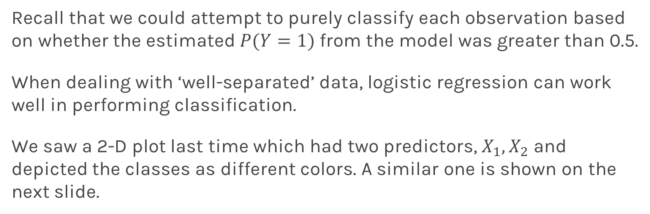
Classification boundaries
Recall that we could attempt to purely classify each observation based on whether the estimated $P(Y=1)$ from the model was greater than 0.5.
When dealing with ‘well-separated’ data, logistic regression can work well in performing classification.
We saw a 2-D plot last time which had two predictors, $X_{1},X_{2}$ and depicted the classes as different colors. A similar one is shown on the next slide.

Slide 55
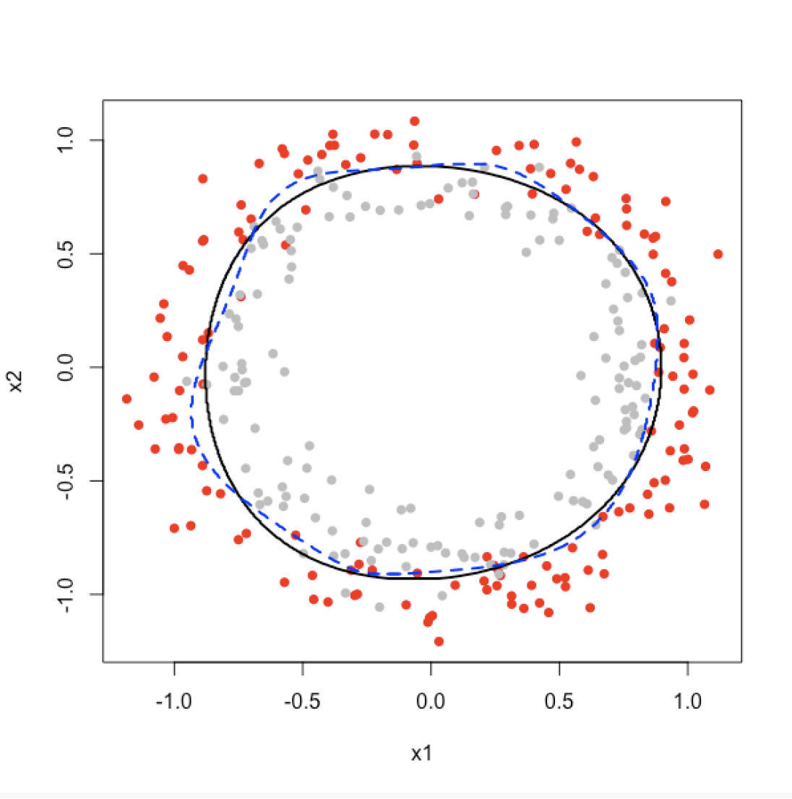
2D Classification in Logistic Regression: an Example

Slide 56
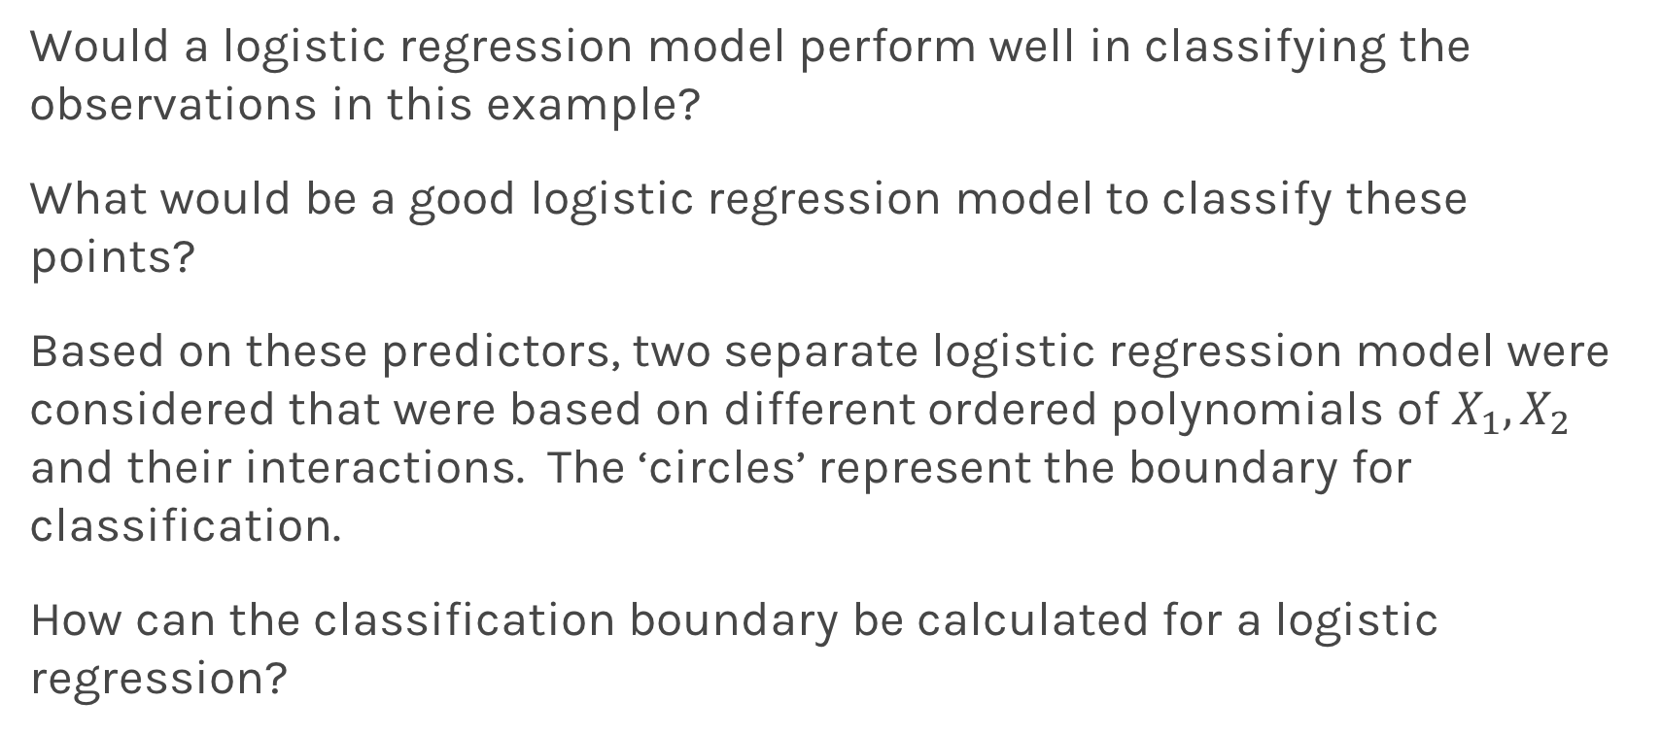
2D Classification in Logistic Regression: an Example
Would a logistic regression model perform well in classifying the observations in this example?
What would be a good logistic regression model to classify these points?
Based on these predictors, two separate logistic regression model were considered that were based on different ordered polynomials of $X_{1},X_{2}$ and their interactions. The ‘circles’ represent the boundary for classification.
How can the classification boundary be calculated for a logistic regression?

Slide 57
2D Classification in Logistic Regression: an Example
In the previous plot, which classification boundary performs better? How can you tell? How would you make this determination in an actual data example?
We could determine the misclassification rates in left out validation or test set(s)

